Slide 1
Core Java

Slide 2
Introduction to Java

Slide 3
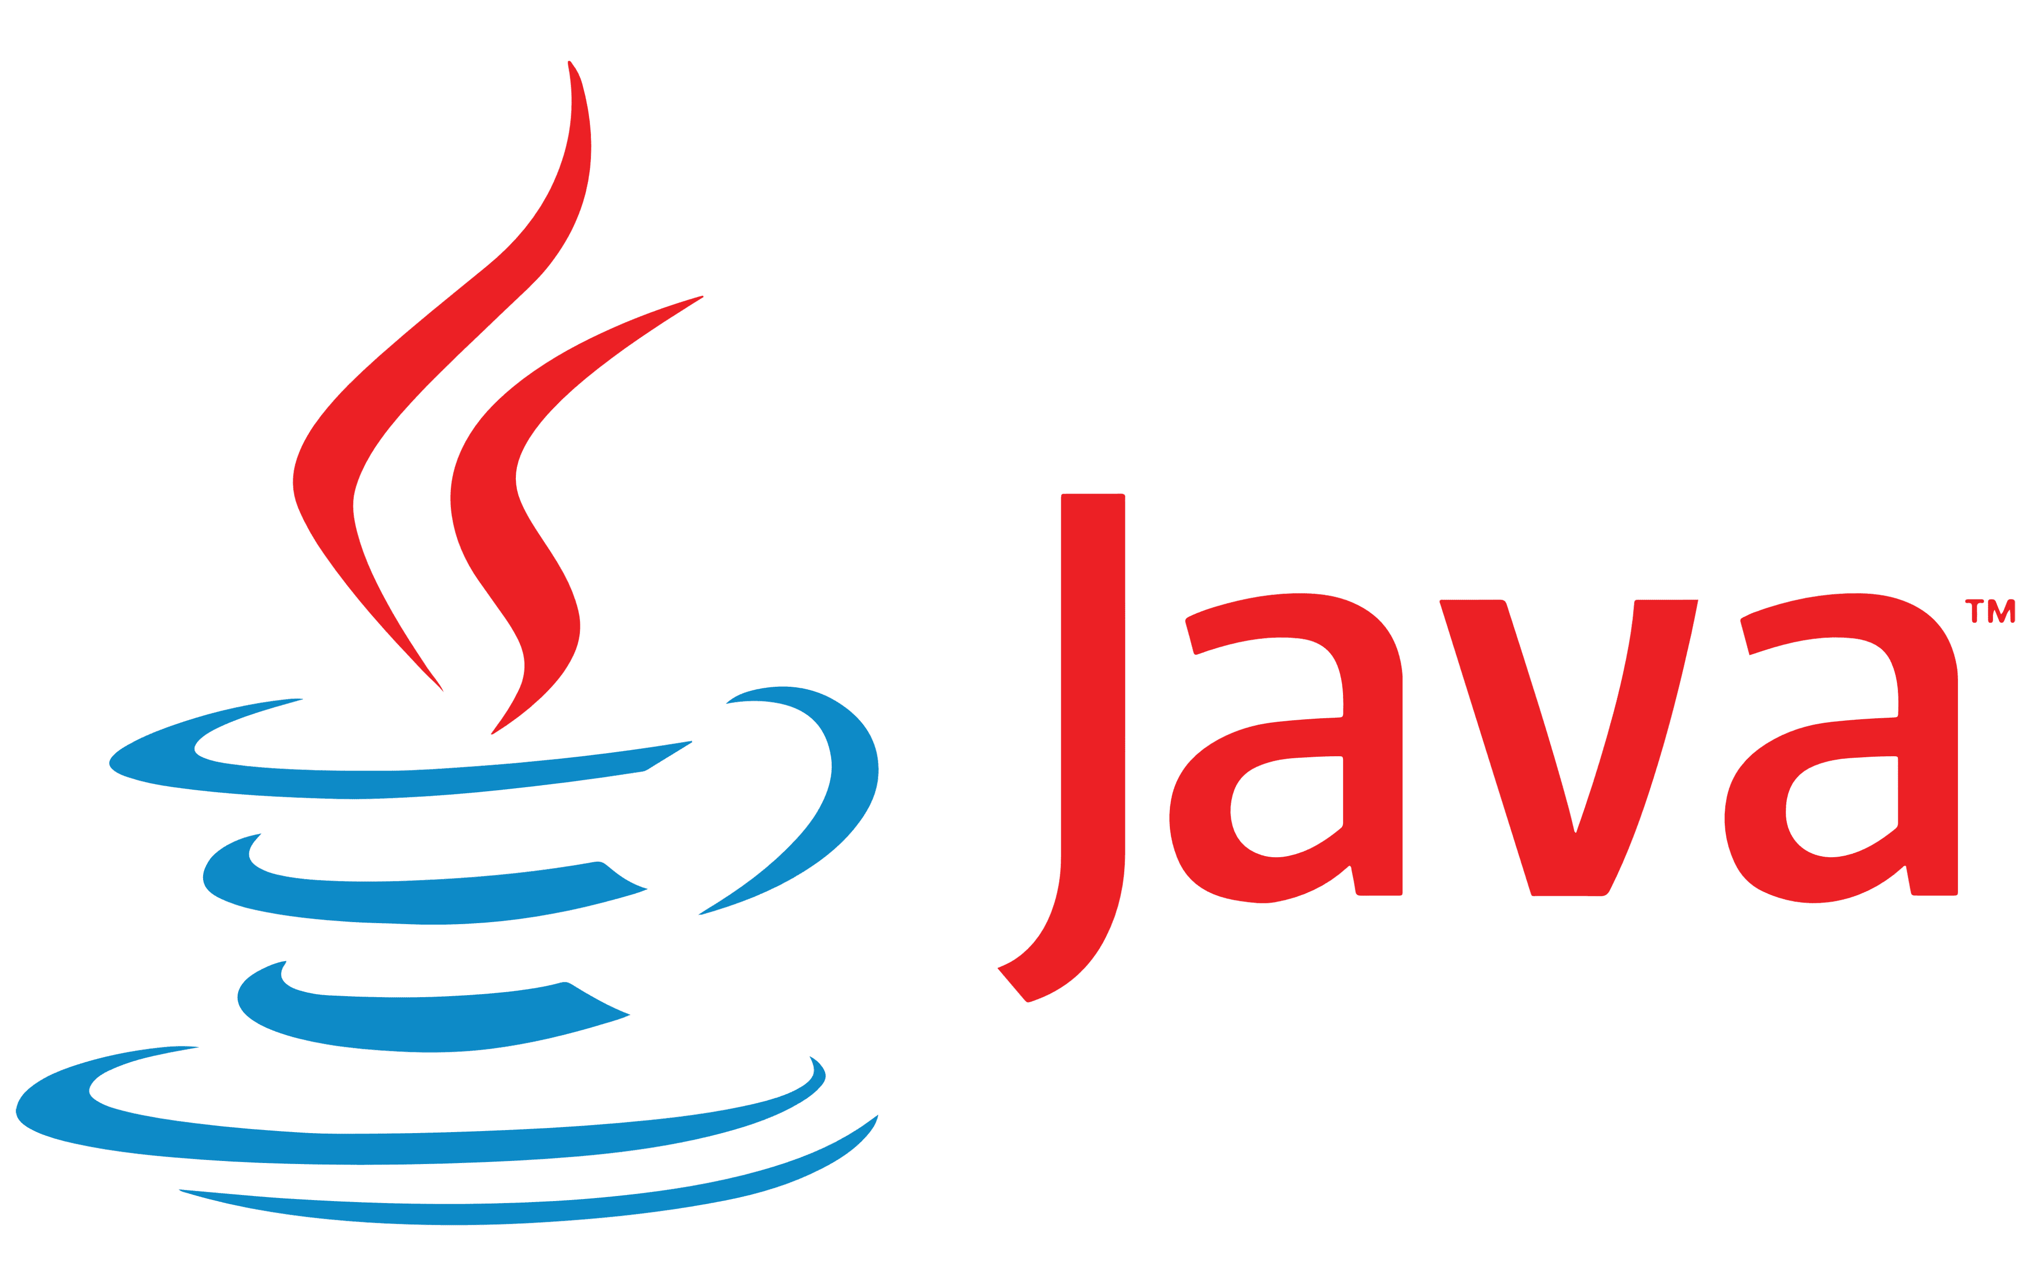
High-level, class-based, object-oriented programming language

Slide 4


History of Java Programming Language
Java is an Object-Oriented programming language developed by James Gosling in the early 1990s. James Gosling, Mike Sheridan, and Patrick Naughton initiated the Java language project in June 1991.
James Gosling
Patrick Naughton
Mike Sheridan

Slide 5

History of Java Programming Language
The language was initially called Oak after an oak tree that stood outside Gosling's office. Later the project went by the name Green and was finally renamed Java, from Java coffee, a type of coffee from Indonesia.
Java was originally designed for interactive television, but it was too advanced for the digital cable television industry at the time.

Slide 6
Java - General
01
02
“Most popular” language
Runs on a “virtual machine” (JVM)
03
04
More complex than some languages (e.g., Python)
Simpler than others (eg. C++)

Slide 7
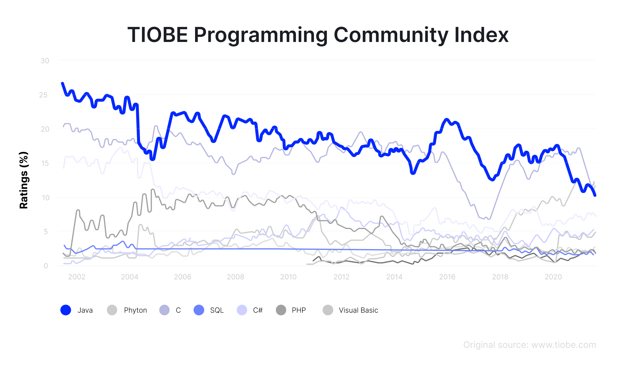
Use of Java
According to a 2020 Stackoverflow survey, Java boasts a 40.2% popularity among developers, with JavaScript having 67.7% and topping the table.

Slide 8
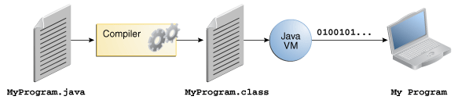
How it works
Java is independent only for a couple of reasons:
Only depends on the Java Virtual Machine (JVM),
code is compiled to bytecode, which is interpreted by the JVM

Slide 9
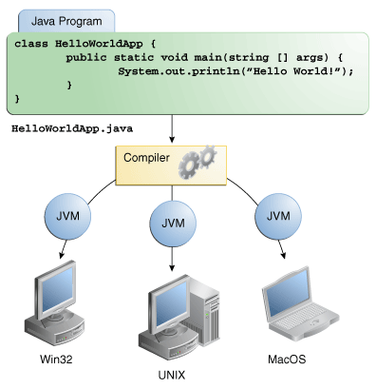
How it works

Slide 10
What is JVM?
The Java Virtual Machine (JVM) is the runtime engine of the Java Platform, which allows any program written in Java or other language compiled into Java bytecode to run on any computer that has a native JVM.
A specification where working of Java Virtual Machine is specified. But implementation provider is independent to choose the algorithm. Its implementation has been provided by Oracle and other companies.
An implementation Its implementation is known as JRE (Java Runtime Environment).
Runtime Instance Whenever you write java command on the command prompt to run the java class, an instance of JVM is created.

Slide 11
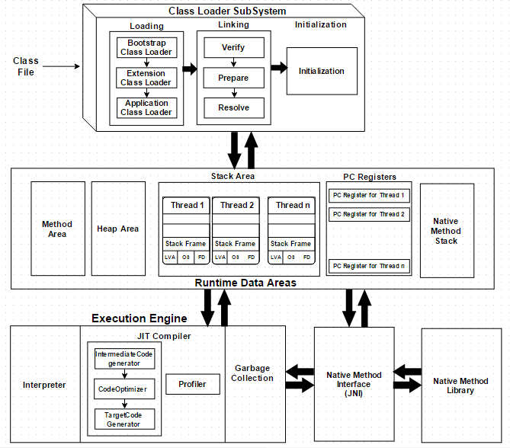
JVM Architecture

Slide 12
What is JDK?
The Java Development Kit (JDK) is one of three core technology packages used in Java programming, along with the JVM (Java Virtual Machine) and the JRE (Java Runtime Environment).
It's important to differentiate between these three technologies, as well as understanding how they're connected:
The JVM is the Java platform component that executes programs.
The JRE is the on-disk part of Java that creates the JVM.
The JDK allows developers to create Java programs that can be executed and run by the JVM and JRE.

Slide 13
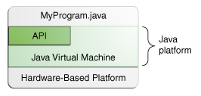
The Java Platform
The Java platform has two components:
The Java Virtual Machine
The Java Application Programming Interface (API)

Slide 14
Java is Object-Oriented
Java supports OOD
Polymorphism
Compile Time(Overloading)
Run-time /Dynamic Method Dispatch
Inheritance
Single
Multiple(Java Does not Support)
Hierarchical
Encapsulation
Java programs contain nothing but definitions and instantiations of classes
Everything is encapsulated in a class!

Slide 15
Advantages & Disadvantages
Portable - Write Once, Run Anywhere
Security has been well thought through
Robust memory management
Designed for network programming
Multi-threaded (multiple simultaneous tasks)
Dynamic & extensible (loads of libraries)
Classes stored in separate files
Loaded only when needed
Java is slow and has a poor performance
Java provides not so attractive look and feels of the GUI
Java provides no backup facility
Java requires significant memory space
Verbose and Complex codes

Slide 16
Java Installation
Download the JDK 1.5 for Windows (Download Link)
Installation Notes for Microsoft Windows 32 bit
Run the JDK installer
Set up Java environment variables
In Windows®, open the Environment Variables dialog.
Set the JAVA_HOME environment variable to the directory where you installed the JDK, for example:C:\Program Files\Java\jdk1.5.0_22. In 64-bit Windows, the default path is C:\Program Files(x86)\Java\jdk1.5.0_22.
In the PATH environment variable, add %JAVA_HOME%\bin; to the beginning of the string.
Click OK to save and close the Environment Variables dialog.
Verify that your environment variables are set correctly.
Open a command prompt
Type java -version and verify that the Java version is the same as the version that you set in the environment

Slide 17

Download IJ
Download intel IJ
https://www.jetbrains.com/idea/download/#section=windows

Slide 18



What is JAVA Compiler
Java Compiler and Interpreter are the most fundamental tools in Java language that programmers use during programming.
A compiler in Java is a computer program that is used for compiling Java programs. It is platform-independent. It converts (translates) source code (.java file) into bytecode (.class file).

Slide 19
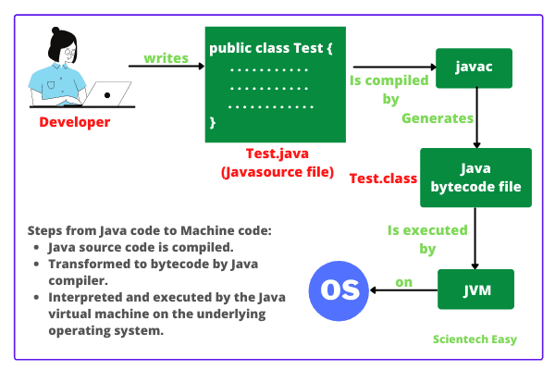
How does Java compiler work?
Image source: scientecheasy

Slide 20
Eclipse
Eclipse is an integrated development environment used in computer programming. It contains a base workspace and an extensible plug-in system for customizing the environment.
Download and install from the below link
https://www.eclipse.org/downloads/download.php?file=/oomph/epp/2022-03/R/eclipse-inst-jre-win64.exe

Slide 21
First Program
class Hello {
public static void main(String[] arguments) {
System.out.println("Hello world.");
}
}
Program Structure
class CLASSNAME {
public static void main(String[] arguments) {
STATEMENTS
}
}

